Slide 1
Operators

Slide 2
Operators
Operators:
An operator is a character that represents a specific mathematical or logical action or process.
Types of operator:
Unary Operator
Arithmetic Operator
Shift Operator
Relational Operator
Bitwise Operator
Logical Operator
Ternary Operator
Assignment Operator

Slide 3
Types of Operator
Unary Operator:
The Unary Operator requires only One operand.
Unary Operator is used to do various operations:
    Incrementing/Decrementing a value by one.
    Negating an expression.
    Inverting the value of a Boolean.

Slide 4
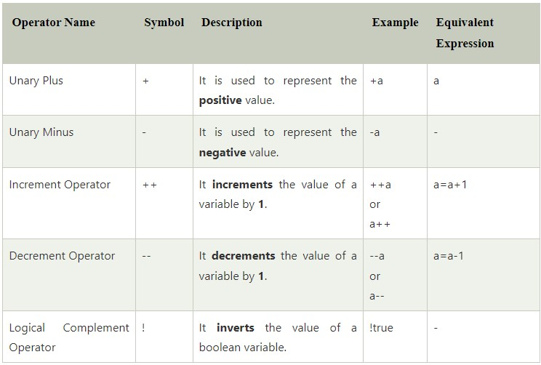
Unary Operator

Slide 5
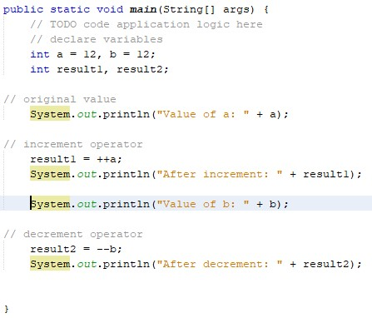

Types of Operator
Unary Operator:
Example: Output:

Slide 6
Types of Operators
Arithmetic Operators:
This operator is used to do Basic Mathematical Operations such as Addition, Subtraction, Multiplication and Division.

Slide 7
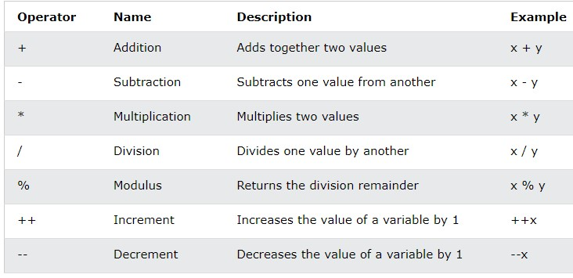
Arithmetic Operator

Slide 8
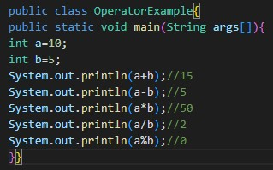

Arithmatic Operator
Example: Output:

Slide 9
Relational Operator
Relational Operator:
Relational operator is used to check the relationship between two operands.

Slide 10
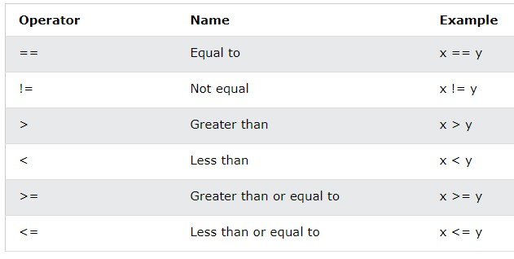
Relational Operator

Slide 11
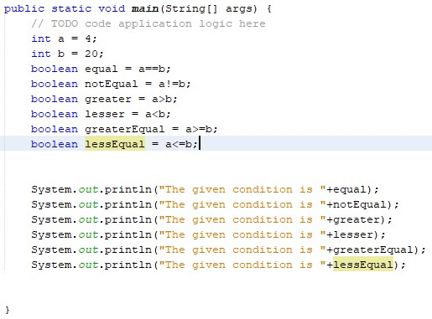
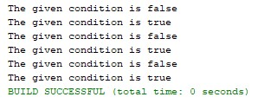
Example: Output:

Slide 12
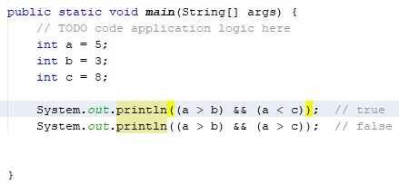

Types of Operators
Logical Operator:
AND Operator:
The Logical && Operator returns true only if the given statements are true. It returns false if one of the conditions is false.
Example: Output:

Slide 13
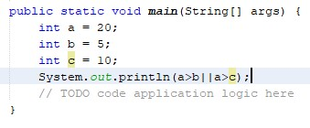

Types of Operators
OR Operator:
The Logical OR(||) operator doesn’t check the second condition if the first condition is true.
Example: Output:

Slide 14


Types of Operators
Not Operator:
The Logical Not(!) operator is used to reverse the result.
Example: Output:

Slide 15
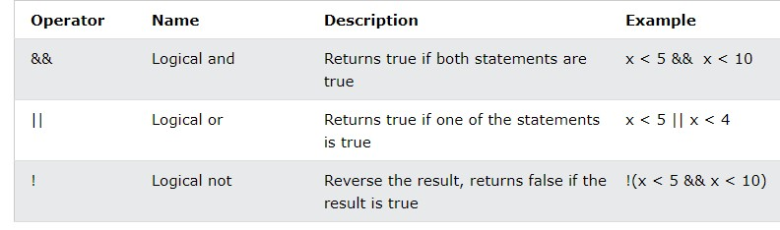
Logical Operator

Slide 16
Types of Operators
Ternary Operator:
The Ternary Operator is used as one line replacement for if-then-else Statement.
It is the only Conditional operator which takes three operands.

Slide 17
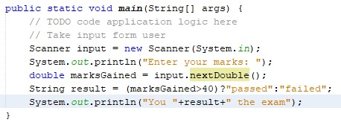


Ternary Operator
Example: Output1:
Output2:

Slide 18
Types of Operators
Assignment Operator:
Java Assignment Operator is one of the most common operators.
It is used to assign the value on its right to the operand on its left.

Slide 19
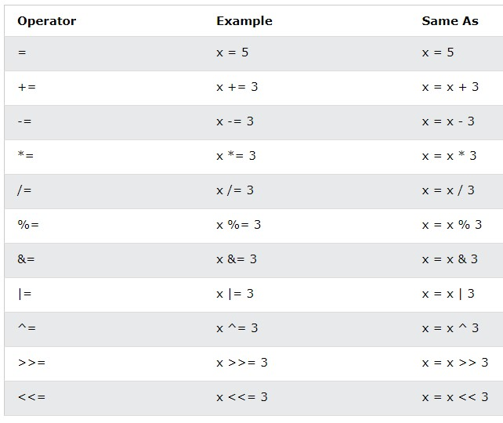
Assignment Operator

Slide 20
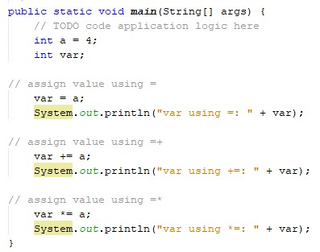

Assignment Operator
Example: output:

Slide 21
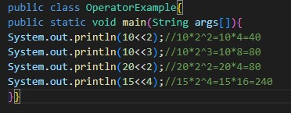

Types of Operators
Left Shift Operator:
The Left Shift Operator(<<) is used to shift all of the bits in a value to the left side of a specified number of times.
Example: Output:

Slide 22
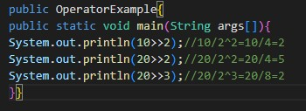

Types of Operators
Right Shift Operator:
The Right Shift Operator(>>) is used to move the value of the left operand to Right side of a specified number of times.
Example: Output:

Slide 23
Thank you

